Slide 1
Laura Zubulake vs. UBS Warburg LLC
Khushi Gupta

Slide 2


Details
Plaintiff: Laura Zubulake
Defendant: UBS Warburg LLC
United States District Court, S.D. New York
District Judge: Shira A. Scheindlin
Case: Claims of Sex Discrimination, failure to promote, and retaliation
Issue Became: To what extent is inaccessible electronic data discoverable, and who should pay for its production?

Slide 3
INTRODUCTION
This case provides an example of the difficulty of balancing the competing needs of broad discovery and manageable costs.
Former Female employee brought a suit against her employer, asserting city, state and federal law gender discrimination and retaliation claims.
The plaintiff requested that the defendant produce " all documents concerning any communication by or between UBS employees concerning the plaintiff."
She asserts that key evidence is located in various e-mails exchanged among UBS employees that now exist only on backup tapes and other archived media.
According to UBS, restoring those e-mails would cost ~$175,000.00, exclusive of attorney time in reviewing the e-mails.
Zubulake now moves for an order compelling UBS to produce those e-mails at its expense.
The district court held that: (1) employee was entitled to discovery of relevant e-mails that had been deleted and resided only on backup disks, and (2) consideration of cost-shifting of discovery costs was proper.

Slide 4
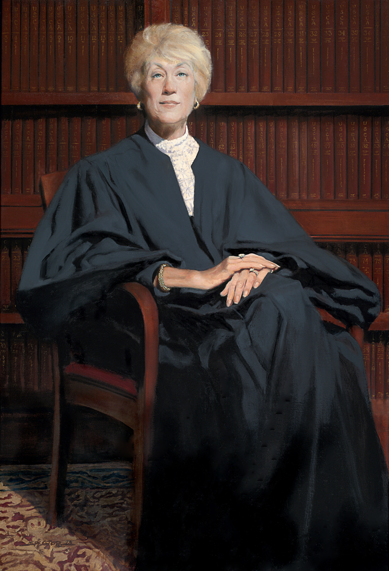
Shira Scheindlin's 5 opinions
During 2003 and 2004, United States District Court Judge Shira A. Scheindlin issued five groundbreaking opinions in this case.
Zubulake is considered the first definitive case in the US on a wide range of E-discovery issues. These issues include:
The scope of a party's duty to preserve electronic evidence during litigation;
Lawyer's duty to monitor their clients' compliance with electronic data preservation and production;
Data sampling;
The ability for the disclosing party to shift the costs of restoring inaccessible back up tapes to the requesting party;
The imposition of sanctions for the spoliation (or destruction) of electronic evidence.

Slide 5
TIMELINE
Aug 1999 – UBS hired Zubulake as a senior salesperson on its U.S. Asian Equities Sales Desk, and reported to Dominic Vail, the Desk's manager. Zubulake was told that she would be considered for Vail's position when it became vacant.
Dec 2000 - Vail left his position to move to the Firm's London office. But Zubulake was not considered for his position, and the Firm hired Matthew Chapin.
Zubulake alleges that Chapin treated her differently than the other male members of the Desk. In particular, Chapin undermined Ms. Zubulake's ability to perform her job by:
ridiculing and belittling her in front of co-workers;
excluding her from work-related outings with male co-workers and clients;
making sexist remarks in her presence; and
isolating her from the other senior salespersons on the Desk by seating her apart from them.
No such actions were taken against any of Zubulake's male coworkers.

Slide 6
TIMELINE
Aug 2001 – Zubulake filed a charged of gender discrimination with the EEOC.
Oct 2001 – Zubulake was fired with two weeks’ notice
Feb 2002 - Zubulake filed an action, suing for gender discrimination and retaliation under Title VII, the New York State Human Rights Law, and the Administrative Code of the City of New York.
March 2002 – UBS timely answered denying allegations
UBS's argument is, that Chapin's conduct was not unlawfully discriminatory because he treated everyone equally badly. UBS says that Chapin's anti-social behavior was not limited to women: a number of male employees on the Desk also complained about him. On the other hand, Chapin was responsible for hiring three new females employees to the Desk.
June 2002 – Zubulake served UBS with her first document request
Notes:
Equal Employment Opportunity Comission

Slide 7
UBS’s E-mail BACKUP SYSTEM
The parties agree that email was an important means of communication at UBS during the relevant time period.
UBS implemented extensive e-mail backup and preservation protocols.
In particular, e-mails were backed up in two distinct ways: on backup tapes and on optical disks.

Slide 8
TIMELINE
July 2002 - UBS produced ~350 pages of documents, including ~100 pages of e-mails. UBS also objected to a substantial portion of Zubulake's requests.
Sep 2002 – UBS agreed to produce responsive e-mails from the accounts of five individuals named by Zubulake: Matthew Chapin, Rose Tong (a human relations representation who was assigned to handle issues concerning Zubulake), Vinay Datta (a co-worker on the Desk), Andrew Clarke (another co-worker on the Desk), and Jeremy Hardisty (Chapin's supervisor and the individual to whom Zubulake originally complained about Chapin).
UBS was to produce such e-mails sent between August 1999 (when Zubulake was hired) and December 2001 (one month after her termination).
UBS, however, produced no additional emails and insisted that its initial production (100 pages of e-mails) was complete. UBS never searched for responsive e-mails on any of its backup tapes. To the contrary, UBS informed Zubulake that the cost of producing e-mails on backup tapes would be prohibitive. (approximately $300,000.00)

Slide 9
Zubulake I: 217 F.R.D 309
Zubulake, believing that the agreement included production of e-mails from backup tapes, objected to UBS's nonproduction. Zubulake knew that there were additional responsive e-mails that UBS had failed to produce because she herself had produced approximately 450 pages of e-mail correspondence. Clearly, numerous responsive e-mails had been created and deleted at UBS, and Zubulake wanted them.
Dec 2002 – UBS was ordered to produce for deposition a person with knowledge of UBS's e-mail retention policies in an effort to determine whether the backup tapes contained the deleted e-mails and the burden of producing them.
Jan 2003 - In response, UBS produced Christopher Behny, Manager of Global Messaging. He testified to UBS's e-mail backup protocol, and also to the cost of restoring the relevant data.

Slide 10
ZUBULAKE 1
Zubulake requested UBS to produce the email from archival media. Claiming undue burden and expense, the defendant urged the court to shift the cost of production to the plaintiff, citing the Rowe decision.
The court noted that the application of the Rowe factors may result in disproportionate cost shifting away from large defendants, and the court modified the test to 7 factors.

Slide 11
Cost shifting analysis
Rowe | Zubulake
Specificity of discovery requests | The extent to which the request is specifically tailored to discover relevant information
Likelihood of discovering critical information | The availability of such information from other sources
Availability of such information from other sources | The total cost of production, compared to the amount in controversy
Purposes for which the responding party maintains the requested data | The total cost of production, compared to the resources available to each party
Relative benefits to the parties of obtaining the information | The relative ability of each party to control costs and its incentive to do so
Total cost associated with production | The importance of the issues at stake in the litigation;
Relative ability of each party to control costs and incentive to do so | The relative benefits to the parties of obtaining the information
Resources available to each party

Slide 12
ZUBULAKE I DECISION
UBS is ordered to produce all responsive e-mails that exist on its optical disks or on its active servers at its own expense.
UBS is also ordered to produce, at its expense, responsive e-mails from any five of the 94 backups tapes selected by Zubulake.
UBS should then prepare an affidavit detailing the results of its search, as well as the time and money spent.
After reviewing the contents of the backup tapes and UBS's certification, the Court will conduct the appropriate cost-shifting analysis.

Slide 13
ZUBULAKE III
UBS reports, that there are only seventy-seven backup tapes that contain responsive data, including the five already restored.
UBS hired Pinkerton Consulting & Investigations, to perform the restoration. Pinkerton was able to restore each of the backup tapes, yielding a total of 6203 e-mails with duplicates eliminated.
Pinkerton then performed a search for e-mails containing the terms “Laura”, “Zubulake”, or “LZ”. The searches yielded 1,075 if duplicates are eliminated. Of these 1,075 e-mails, UBS deemed approximately 600 to be responsive to the document request. UBS also produced, fewer than twenty e-mails extracted from UBS's optical disk storage system.
Pinkerton billed UBS 31.5 hours for its restoration services at an hourly rate of $245, 6 hours for the development, refinement and execution of a search script at $245 an hour, and 101.5 hours of “CPU Bench Utilization” time for use of Pinkerton's computer systems at a rate of $18.50 per hour. Pinkerton also included a five percent “administrative overhead fee” of $459.38. Thus, the total cost of restoration and search was $11,524.63. UBS also incurred the following costs: $4,633 in attorney time for the document review (11.3 hours at $410 per hour) and $2,845.80 in paralegal time for tasks related to document production (16.74 hours at $170 per hour). The total cost of restoration and production from the five backup tapes was $19,003.43.
UBS now asks that the cost of any further production—estimated to be $273,649.39, based on the cost incurred in restoring five tapes and producing responsive documents from those tapes—be shifted to Zubulake. The total figure includes $165,954.67 to restore and search the tapes and $107,694.72 in attorney and paralegal review costs.

Slide 14
ZUBULAKE III DECISION
After applying the seven–factor test, it determined that the plaintiff should account for 25 percent of the restoration and searching costs, excluding attorney review costs.

Slide 15
ZUBULAKE IV – get’s worse for ubs
In the restoration effort, the parties discovered that certain backup tapes are missing. In addition, certain isolated e-mails-created after UBS supposedly began retaining all relevant e-mails were deleted from UBS's system, although they appear to have been saved on the backup tapes.
For example, an e-mail from Chapin to Joy Kim [another of Zubulake's co-workers] instructing her on how to file a complaint against Zubulake was not saved, and it bears the subject line ‘UBS client attorney priviledge only,’ although no attorney is copied on the e-mail. This potentially useful e-mail was deleted and resided only on UBS's backup tapes.”
In Aug 2001, UBS ordered its employees to retain all relevant documents. In Aug 2002, after Zubulake specifically requested e-mail stored on backup tapes, UBS's outside counsel instructed UBS's information technology personnel to stop recycling backup tapes.
The court also found that the defendant failed to comply with its own retention policy, which would have preserved the missing evidence.

Slide 16
Zubulake iv decision
Zubulake now seeks sanctions against UBS for its failure to preserve the missing backup tapes and deleted e-mails. In particular, Zubulake seeks the following relief:
(a) an order requiring UBS to pay in full the costs of restoring the remainder of the monthly backup tapes;
(b) an adverse inference instruction against UBS with respect to the backup tapes that are missing;
(c) an order directing UBS to bear the costs of re-deposing certain individuals, such as Chapin, concerning the issues raised in newly produced e-mails.
Although, UBS had a duty to preserve all of the backup tapes at issue, and destroyed them with the requisite culpability, Zubulake cannot demonstrate that the lost evidence would have supported her claims. Under the circumstances, it would be inappropriate to give an adverse inference instruction to the jury.
UBS must now bear Zubulake's costs for re-deposing certain witnesses for the limited purpose of inquiring into issues raised by the destruction of evidence and any newly discovered e-mails.
In particular, UBS is ordered to pay the costs of re-deposing Chapin, Hardisty, Tong, and Josh Varsano (a human resources employee in charge of the Asian Equities Sales Desk).

Slide 17
ZUBULAKE V
Zubulake once again moved to sanction UBS for its failure to produce relevant information and for its late production of such material.
Zubulake filed an initial charge of gender discrimination with the EEOC on August 16, 2001. Well before that, however—as early as April 2001—UBS employees were on notice of Zubulake's impending court action.
Fully aware of their common law duty, the counsel ensured that relevant information is preserved by giving clear instructions to the client to preserve such information. UBS's counsel—both in-house and outside—instructed UBS personnel to retain relevant electronic information and keep them separate for lawyer’s review.
This warning pertained to both electronic and hard-copy files, but did not specifically pertain to “backup tapes,” maintained by UBS’s IT personnel.
Notwithstanding these instructions, UBS employees —Orgill, Hardisty, Holland, Chapin, Varsano, and Amone—failed to retain e-mails related to Zubulake's claims. Some of the deleted e-mails were restored from backup tapes (or other sources), others have been altogether lost, though there is strong evidence that they once existed.

Slide 18
ZUBULAKE V
Counsel, in turn, failed
to request retained information from one key employee
to give the litigation hold instructions to another,
to adequately communicate with another employee about how she maintained her computer files,
to safeguard backup tapes that might have contained some of the deleted e-mails, and which would have mitigated the damage done by UBS's destruction of those e-mails.
At least one e-mail has been lost; the existence of that e-mail is known only because of oblique references to it in other correspondence. Other e-mails were deleted in contravention of counsel's “litigation hold” instructions, but were subsequently recovered from alternative sources—such as backup tapes—and thus produced to Zubulake, almost two years after she propounded her initial document requests.

Slide 19
EXAMPLES
An e-mail from Hardisty to Holland (Chapin was copied) reported that Zubulake said “that all she wanted is to be treated like the other ‘guys' on the desk.” That e-mail was recovered from Hardisty's August 2001 backup tape—and thus it was on his active server as late as August 31, 2001 but was not in his active files. That e-mail therefore must have been deleted subsequent to counsel's warnings.
There are a number of e-mails that were absent from UBS's initial production even though they were not deleted. These e-mails existed in the active, on-line files of UBS employees—Kim and Tong—but were not produced to counsel and thus not turned over to Zubulake until she learned of their existence as a result of her counsel's questions at deposition. Indeed, these e-mails were not produced until after Zubulake had conducted thirteen depositions and four re-depositions.
During her February 19, 2004, deposition, Kim testified that she was never asked to produce her files regarding Zubulake to counsel, nor did she ever actually produce them, although she was asked to retain them. One week after Kim's deposition, UBS produced seven new e-mails. Subsequent to the deposition, counsel for the first time asked Kim to produce her files. Included among the new e-mails produced from Kim's computer was one that recounts a conversation between Zubulake and Kim in which Zubulake complains about the way women are treated at UBS.
Laura Zubulake contended that UBS, which recovered some of the deleted relevant emails, prejudiced her case by producing recovered emails long after the initial document requests. Additionally, parts of important communication exchanged between key parties was never recovered, including an email that would reveal a relevant conversation about the employee.

Slide 20
Counsel’s FAILURES
Outside counsel issued a litigation hold in Aug. 2001. The hold order was circulated to many of the key players in this litigation, and reiterated in e-mails in February 2002, when suit was filed, and again in September 2002. Then, outside counsel made clear that the hold order also applied to backup tapes in August 2002.
The counsel instructed UBS employees to produce copies of their active computer files. Yet UBS personnel failed to preserve plainly relevant e-mails.
“It is true that counsel need not supervise every step of the document production process and may rely on their clients in some respects,” counsel is responsible for coordinating her client's discovery efforts. In this case, counsel failed to properly oversee UBS, both in terms of its duty to locate relevant information and its duty to preserve and timely produce that information.
With respect to making sure that relevant data was retained, counsel failed in a number of important respects.
First, neither in-house nor outside counsel communicated the litigation hold instructions to Mike Davies, a senior human resources employee who was intimately involved in Zubulake's termination.
Second, even though the litigation hold instructions were communicated to Kim, no one ever asked her to produce her files.
Third, counsel failed to protect relevant backup tapes; had they done so, Zubulake might have been able to recover some of the e-mails that UBS employees deleted.
In sum, while UBS personnel deleted e-mails, copies of many of these e-mails were lost or belatedly produced as a result of counsel's failures.
Counsel failed to communicate the litigation hold order to all key players. They also failed to ascertain each of the key players' document management habits. UBS employees—for unknown reasons—ignored many of the instructions that counsel gave. This case represents a failure of communication, and that failure falls on counsel and client alike.
Though more diligent action on the part of counsel would have mitigated some of the damage caused by UBS's deletion of e-mails, UBS deleted the e-mails in defiance of explicit instructions not to.

Slide 21
THE VERDICT
UBS failed to preserve relevant e-mails, even after receiving adequate warnings from counsel, resulting in the production of some relevant e-mails almost two years after they were initially requested, and resulting in the complete destruction of others.
The court concluded that the defendant deliberately acted in destroying relevant information and failing to follow the instructions and demonstrate care on preserving and recovering key documents.
As a result, Judge Shira Scheindlin ordered an adverse inference instruction against UBS Warburg. The jury found in Zubulake's favor on both claims awarding compensatory and punitive awards.
For that reason, Zubulake's motion is granted and sanctions are warranted. UBS is ordered to:
1. Pay for the re-deposition of relevant UBS personnel, limited to the subject of the newly-discovered e-mails;
2. Restore and produce relevant documents from Varsano's August 2001 backup tape;
3. Pay for the re-deposition of Varsano and Tong,
4. Pay all “reasonable expenses, including attorney's fees,” incurred by Zubulake in connection with the making of this motion.

Slide 22

THE VERDICt
The court noted that the defence counsel was partly to be blamed for the document destruction because it had failed in its duty to locate and preserve relevant information. The court stated:
“counsel must take affirmative steps to monitor compliance so that all sources of discoverable information are identified and searched".
Attorneys are obligated to ensure all relevant documents are discovered, retained, and produced.
litigators must guarantee that relevant documents are preserved by instituting a litigation hold on key data, and safeguarding archival media.

Slide 23
AMENDMENTS TO THE FRCP (2006)
Rule 34
Electronically stored information [Amended Rule 34(a)]: added category of ESI other than discovery of ‘documents’ and ‘things’
Test or sample [Amended Rule 34(a)]: right to test or sample ESI
Form of production [Amended Rule 34(b)]: requesting party can specify the form of producing ESI
Rule 26
Initial disclosures [Amended Rule 26(a)(1)(B)]: adds category of ESI to what a party may disclose
Production issues and accessibility [Amended Rule 26(b)(2)(B)]: ESI need not to be produced if the source is not reasonably accessible (undue burden or undue cost)
Rule 26(b)(2)(C): court may set limits to the permitted scope of discovery and shift the some of the production costs to the requesting party
Privileged and trial-preparation information [Amended Rule 26(b)(5)(B)]: creates a process and procedure to stop the spread of an initial disclosure - figuratively, a 'litigation hold’
Conference of parties to plan discovery [Amended Rule 26(f)]: pretrial planning conference

Slide 24
AMENDMENTS TO THE FRCP (2006)
Rule 33
Production as answer [Amended Rule 33(d)]: right to produce ESI in answer to an interrogatory.
Scheduling order [Amended Rule 16(b)]: adds provisions for disclosure of ESI
Safe harbor [Amended Rule 37(f)]: court may not impose sanctions on a party for failing to provide ESI as a result of a good faith operation.
Amended Rule 45: conforms the procedures for subpoenas to the other discovery rules, including the category of ESI, providing for the form of production, protecting sources of information not easily accessible, etc.

